Slide 1
Introduction to Deep Learning
Lecture 1

Slide 2
What is Deep Learning?
A subset of machine learning that uses neural networks with multiple layers to model complex patterns in data.
Mimics the human brain's structure and function.

Slide 3
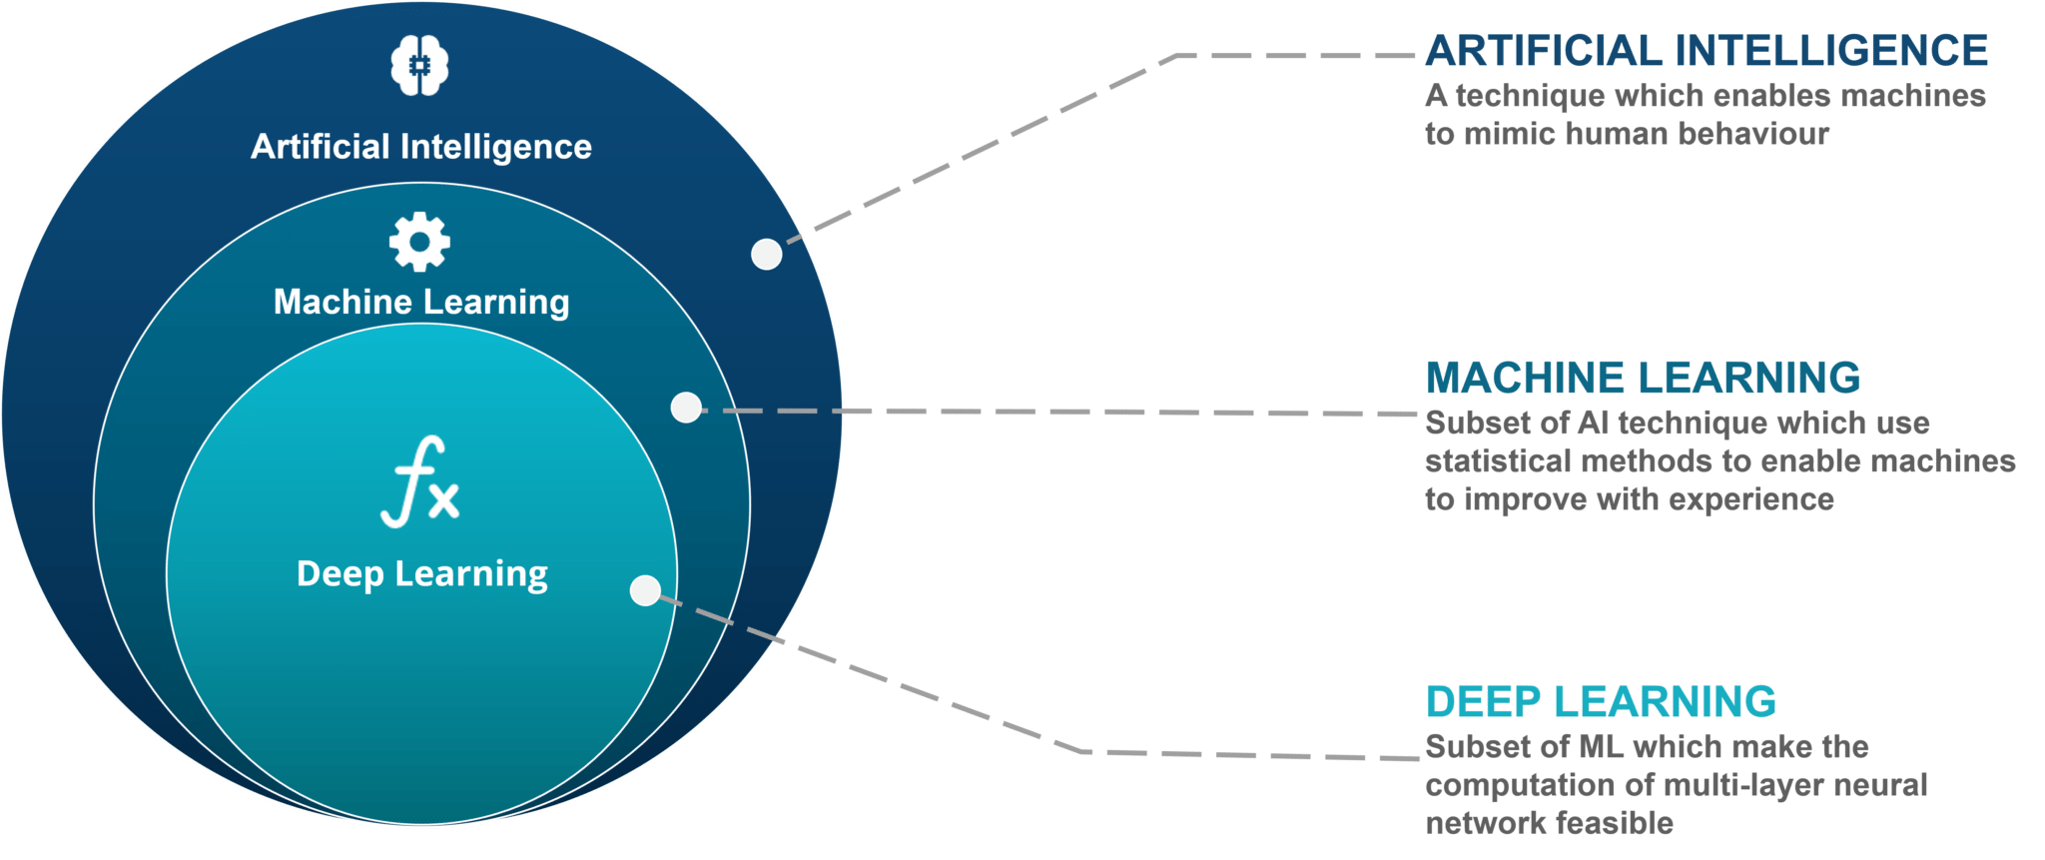
Umbrella Diagram
https://www.edureka.co/blog/ai-vs-machine-learning-vs-deep-learning/

Slide 4
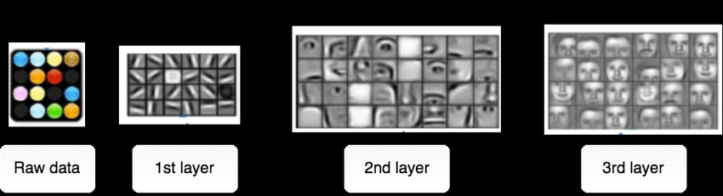
Continue…..
https://www.researchgate.net/publication/326412238_Deep_generative_neural_networks_for_novelty_generation_a_foundational_framework_metrics_and_experiments/figures?lo=1&utm_source=google&utm_medium=organic

Slide 5
Why Deep Learning
Handles Complex Data
Automates Feature Engineering
State-of-the-Art Performance
Scalability with Big Data
Continuous Innovation

Slide 6
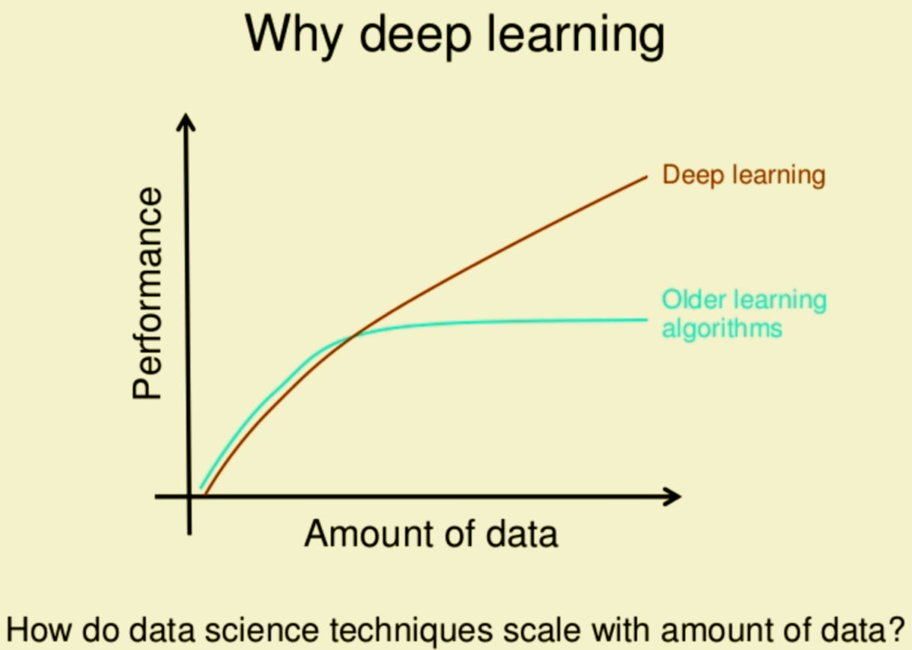
Why Deep Learning

Slide 7
Why not Deep Learning
Small datasets (deep learning requires large amounts of data).
Simple problems
Limited computational resources.
Need for interpretability (deep learning models are often "black boxes").

Slide 8
Future of Deep Learning
More efficient and interpretable models
Deploying deep learning on edge devices (e.g., smartphones, IoT).
Solving global challenges like climate change and healthcare.
Combining with quantum computing, robotics, and blockchain.

Slide 9
Neural Networks

Slide 10
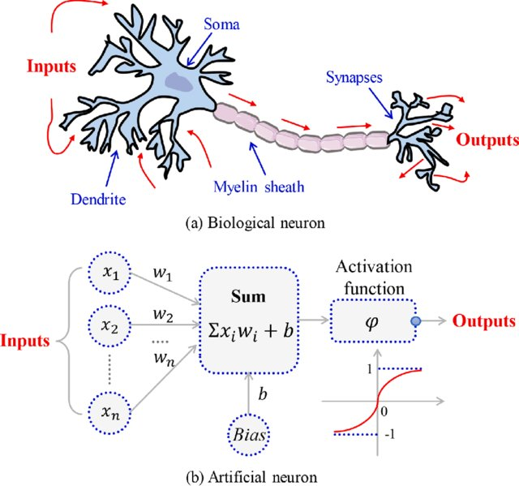
Biological Vs Artificial Neuron
https://www.researchgate.net/publication/351372032_Bond_strength_prediction_of_concrete-encased_steel_structures_using_hybrid_machine_learning_method/figures

Slide 11
Perceptron
Perceptron was introduced by Frank Rosenblatt in 1957.
A single-layer neural network is used for binary classification tasks.
Input Layer: Receives input features (e.g., x1,x2,...,xnx1​,x2​,...,xn​).
Weights: Each input is multiplied by a weight (w1,w2,...,wnw1​,w2​,...,wn​).
Activation Function: A step function (e.g., Sigmoid function) to produce the output (0 or 1).

Slide 12
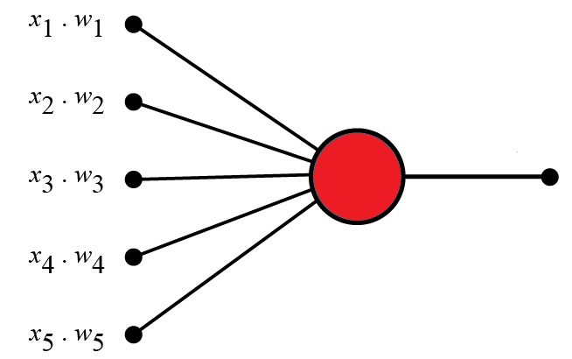
Architecture of Perceptron

Slide 13
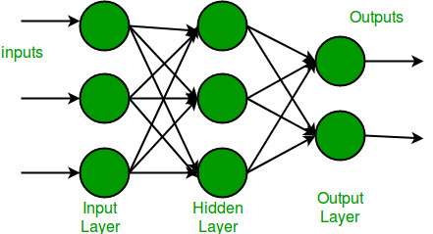
Multi-Layer Perceptron
Feedforward artificial neural network (ANN) with one or more hidden layers between the input and output layers.
Extends the single-layer perceptron.

Slide 14
How ANN Works
Input Features/Layer
Hidden Layer
Activation Function
Output Layer
X1
W1
Sigmoid
W2
X2
W3
X3
Y=w1x1+w2x2+w3x3….wnxn+bias

Slide 15
Example
Let's say:
x1 = 2, x2 = 3, x3 = 1
w1 = 0.5, w2 = -0.2, w3 = 0.8
b = 0.1
Activation function: Sigmoid
Weighted Sum: sum = (2 * 0.5) + (3 * -0.2) + (1 * 0.8) + 0.1 = 1 - 0.6 + 0.8 + 0.1 = 1.3
Activation: y = 1 / (1 + exp(-1.3)) ≈ 0.785
So, the neuron's output for these inputs would be approximately 0.785.

Slide 16
Activation Functions
Sigmoid
Relu

Slide 17
Activation Functions (Sigmoid)
Formula: f(x) = 1 / (1 + exp(-x))
Output: Between 0 and 1.
Use cases: Historically popular, but less used in deep learning now due to vanishing gradient issues. Still sometimes used in output layers for binary classification.

Slide 18
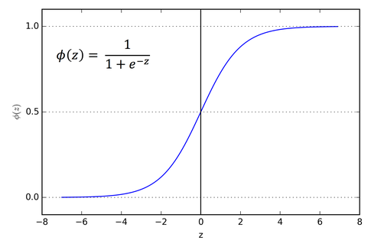
Activation Functions (Sigmoid)

Slide 19
Relu (Rectified Linear Unit)
Formula: f(x) = max(0, x)
Output: 0 for negative input, x for positive input.
Use cases: Very popular in deep learning. It helps to solve the vanishing gradient problem and often leads to faster training.

Slide 20
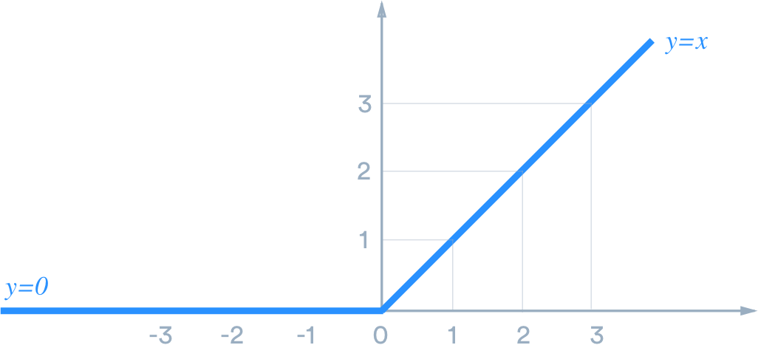
Relu (Rectified Linear Unit)

Slide 21
Why Activation Functions
Real-world data is rarely linearly separable
Introduce Non-linearity
No matter how many layers you have, a network without activation functions is equivalent to a single-layer perceptron, severely limiting its capacity
They decide whether the neuron should be "activated" or not.

Slide 22
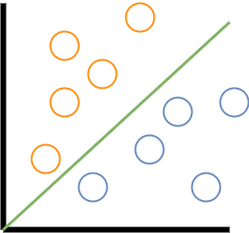
Why Activation Functions

Slide 23

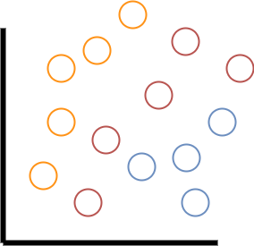
Why Activation Functions

Slide 24
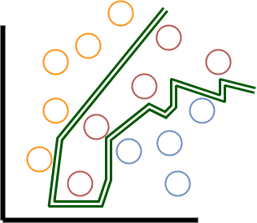
Why Activation Functions

Slide 25
Class Participation
Determine whether the neuron will activate or not. If the weighted sum is greater than or equal to 0.60, then output "Neuron activated" or 1; otherwise, output "Not activated" or 0.
x1 = 5, x2 = 2, x3 = 7
w1 = 0.25, w2 = 0.10, w3 = 0.50
b = 0.15
Note: Use the Sigmoid activation function.

